Slide 1
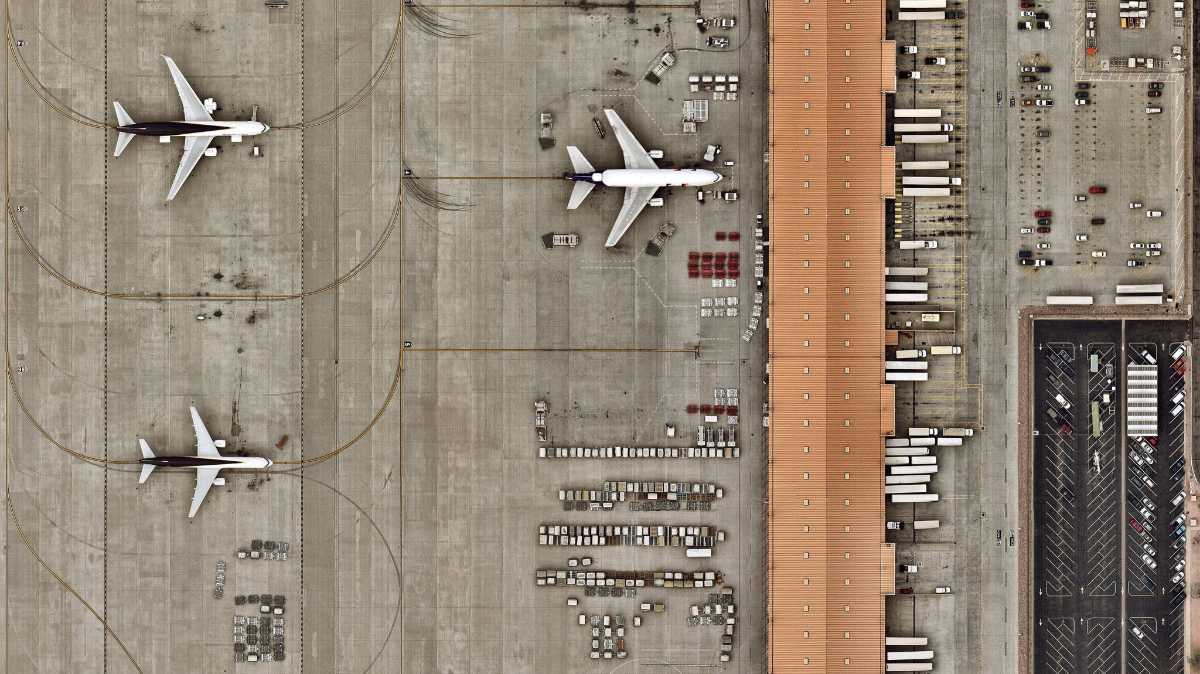
Delta Airlines Black Box System Project
By: Team 3 ( Nimesh Basnet, Fanial WOldu, UDAY PUTTIREDDI, Logan Fischer, And Annus Shakeel)

Slide 2
Agenda
Key Findings
Challenges
Introduction
Project Scope
Diagrams (Level 0,1 and ERD)
User Stories
Test Cases
Defect Reports
Metrics Analysis
Summary and Next Steps

Slide 3
Key Findings
Lack of communication within the group can lead to misaligned efforts and inaccurate outcomes.
The team became more efficient as we implemented proper Agile methods, fostering better collaboration and streamlined workflows.
Having a well-structured and logical thinking pattern is essential when designing a Black Box System to ensure accuracy and effectiveness.

Slide 4
Challenges:
Keeping the project in the scope, without having scope creep
Using new software throughout the process.
Co-ordinating a time that worked for all the team members as well as with mentors.
When reverse engineering, being able to think of things in extra details.
Putting the defect with right severity and priority

Slide 5

Introduction
Our team was responsible for researching, designing, simulating, validating, and presenting a reimagined version of the current Delta Airlines System and Website.
Key Objectives:
Ensure robust functionality and usability.
Identify and resolve critical defects.
Improve system reliability through extensive testing.

Slide 6
Project Scope:
In-Scope:
System diagrams at level 0 and 1, illustrating overall system architecture.
Development of risk assessment, test cases, defect tracking and project metrics
Integration of Delta’s personalized travel options and digital ID functionality
Out-of-scope:
Real-time data integration with live Delta system.
Production environment deployment
Vacation package, including the booking of hotels, and car.

Slide 7
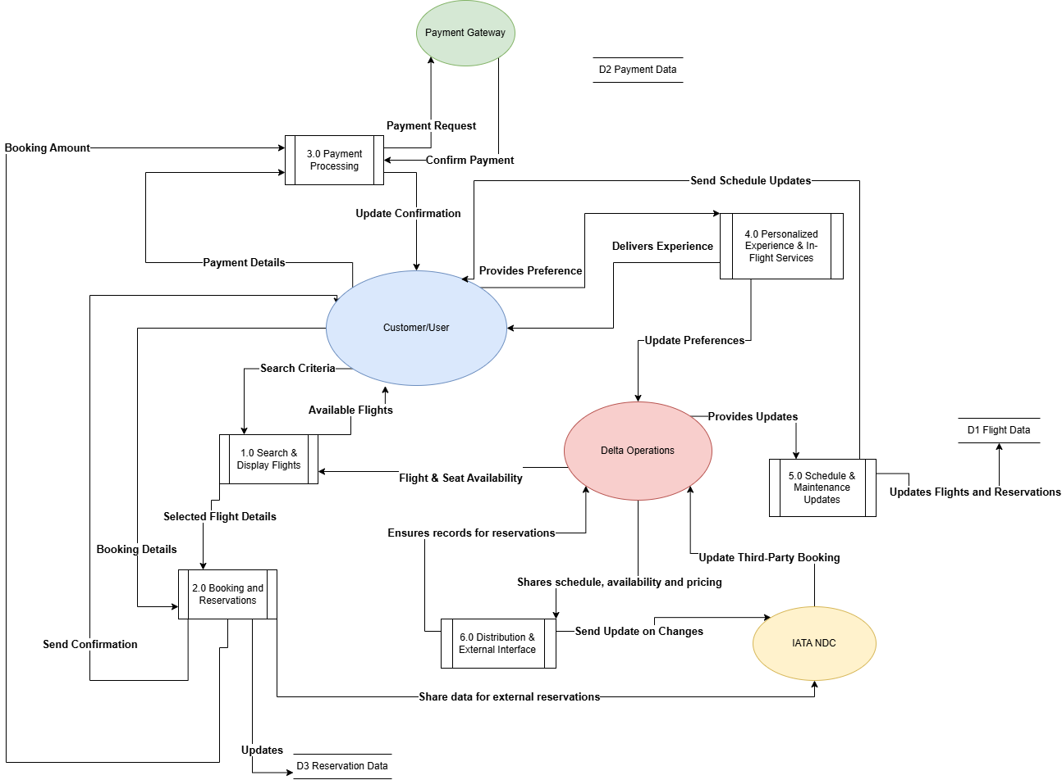
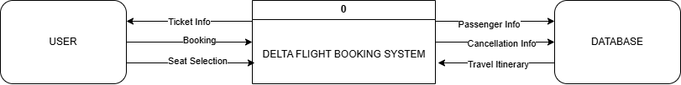
Diagrams (Level 0 and 1)

Slide 8
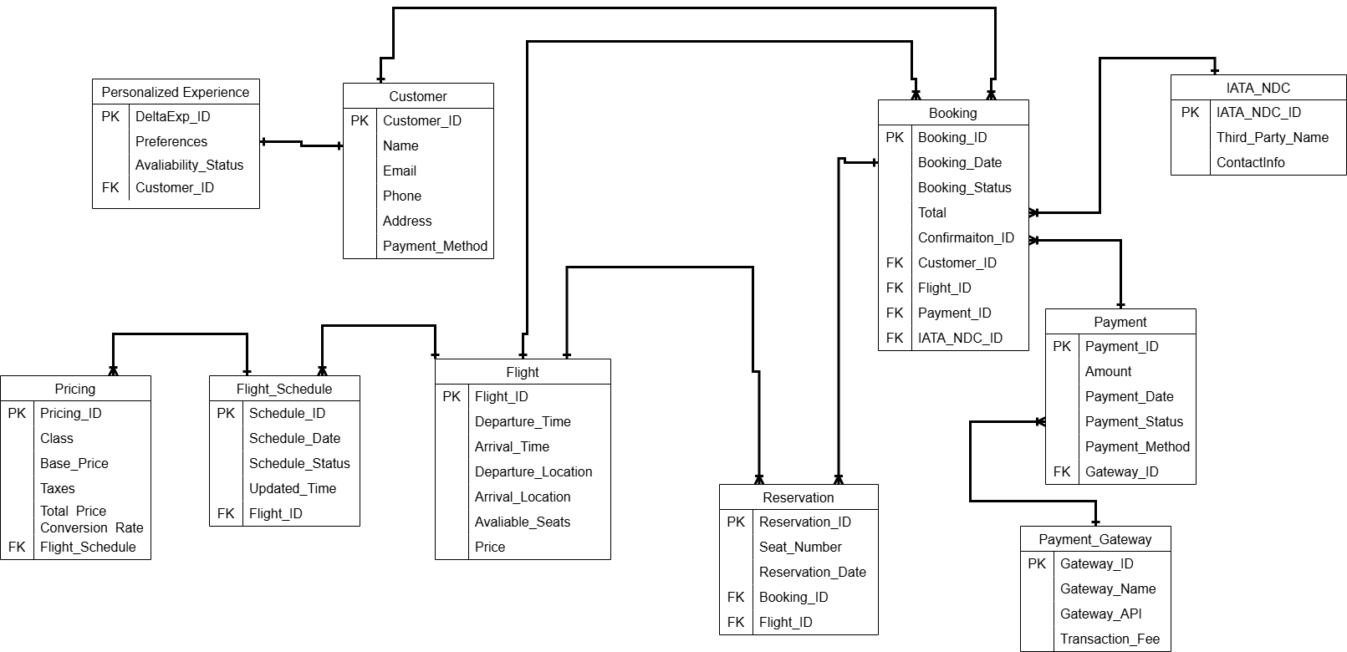
Diagrams (ERD)

Slide 9
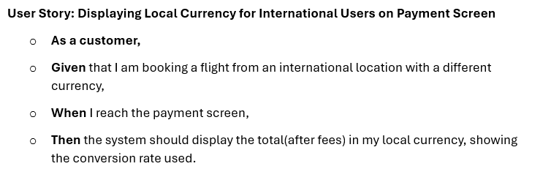
User Stories (Display Local Currency)

Slide 10
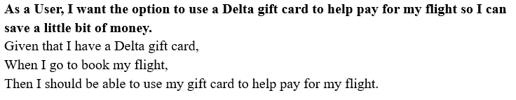
User Stories

Slide 11
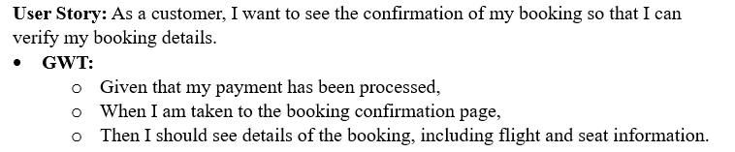
User Stories

Slide 12
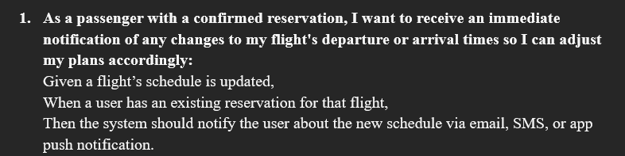
User Stories

Slide 13
Test Cases Overview:
Total Test Cases
50 (Ten per member)
Priority Levels
Low (L), Medium (M), and High (H)
Prioritize
Prioritize test cases based on priority level
Test Case Types
positive, negative, false negative, and false positive

Slide 14
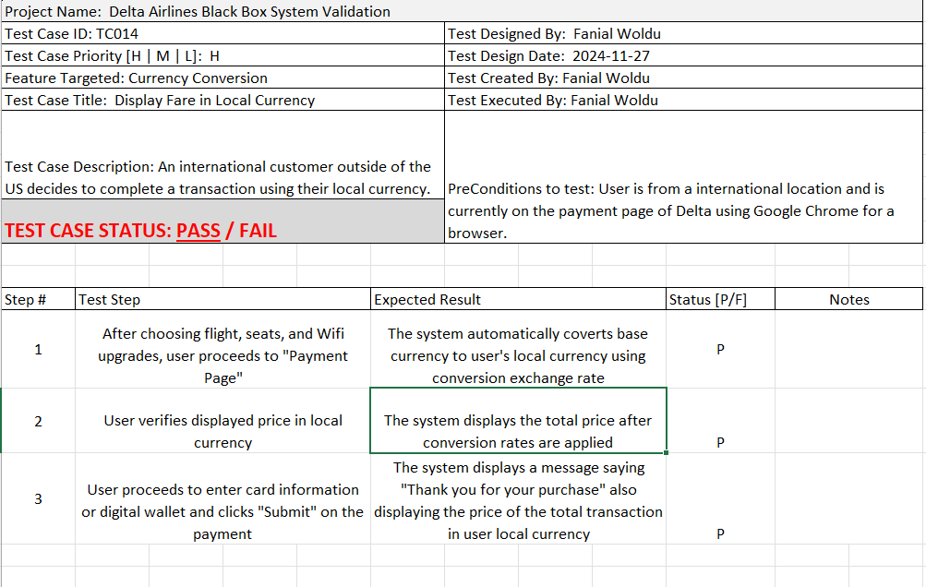
Test Case (Display Fare in Local Currency)

Slide 15
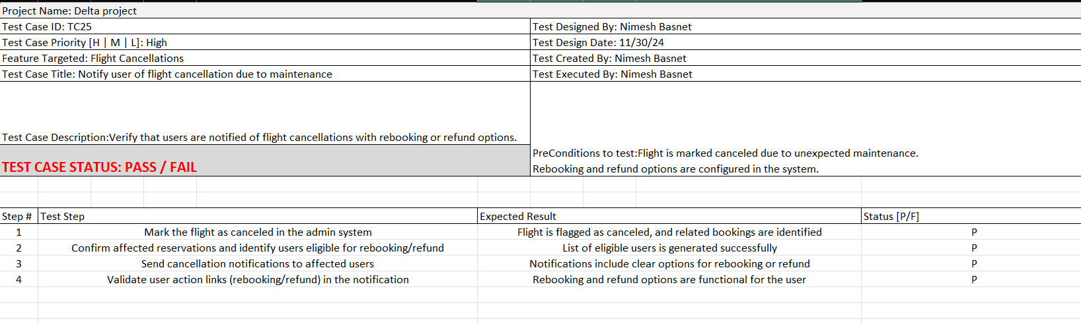
Test Case (Flight Cancellations)

Slide 16
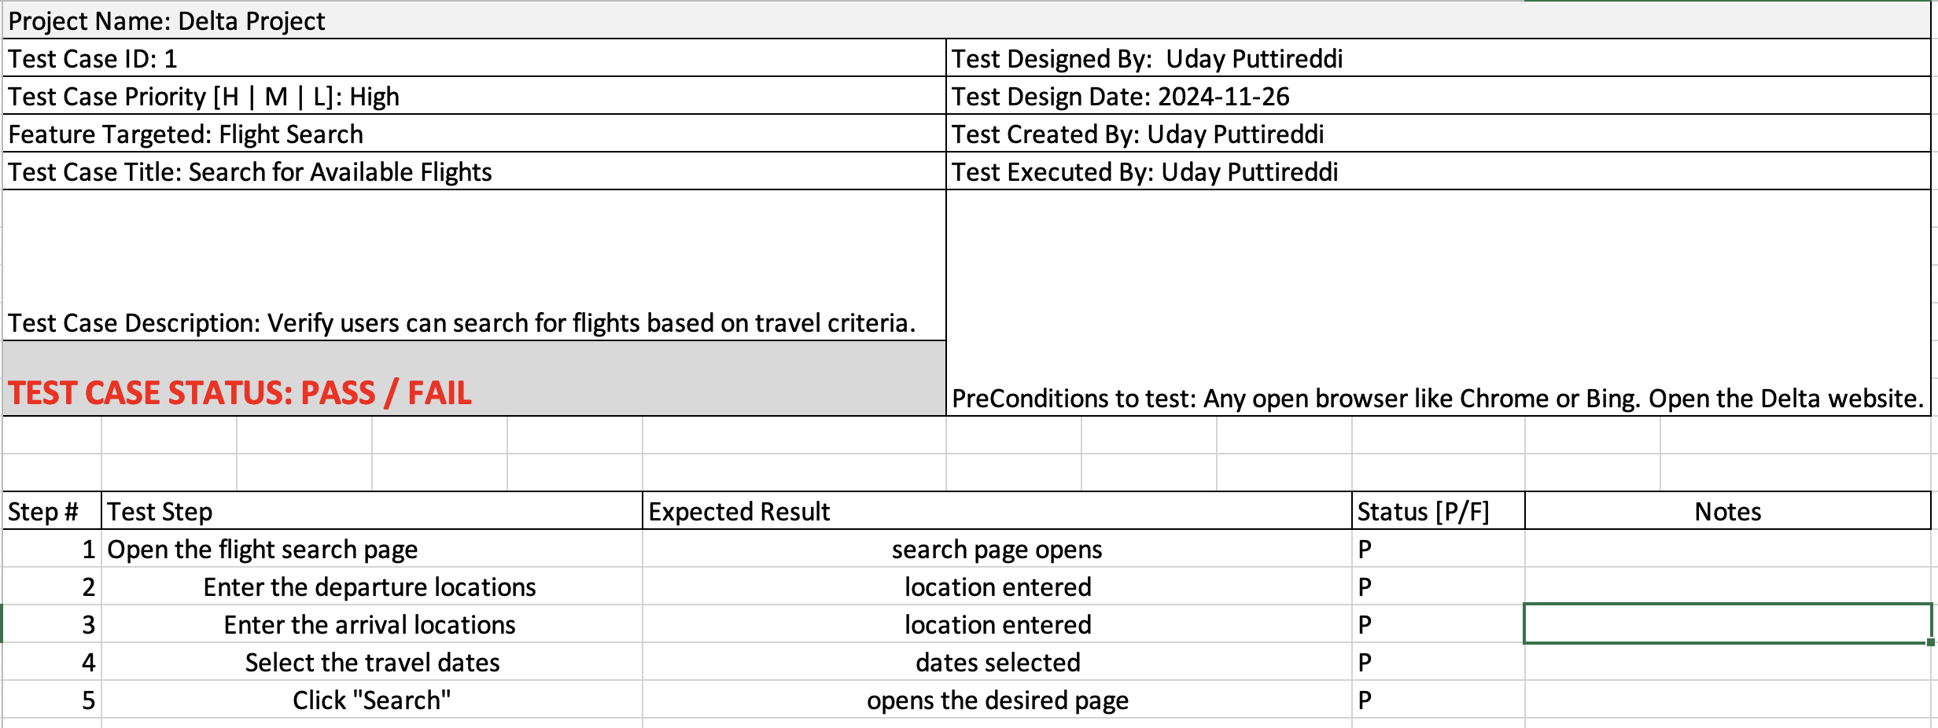
Test Case (Search for Available Flights)

Slide 17
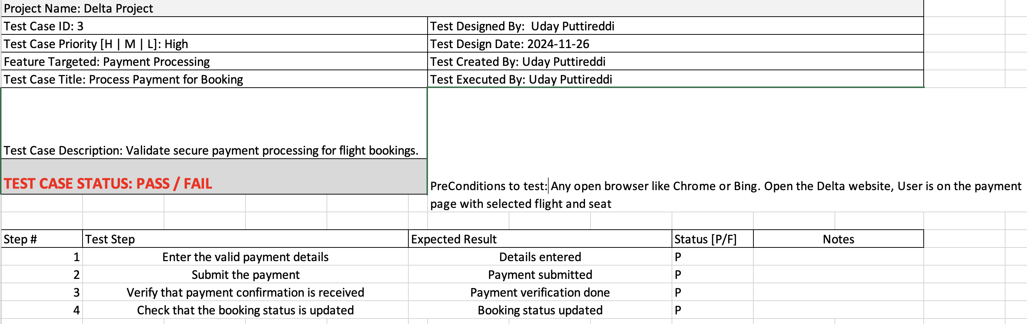
Test Case (Payment Process)

Slide 18
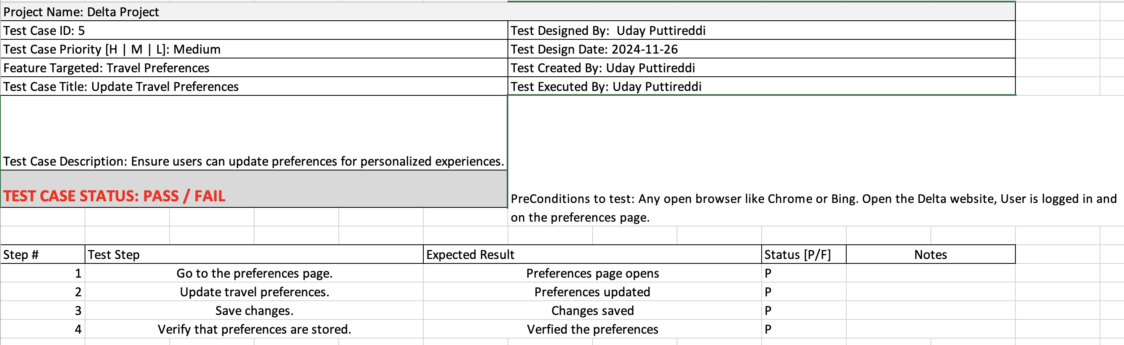
Test Case (Update Travel Preferences)

Slide 19
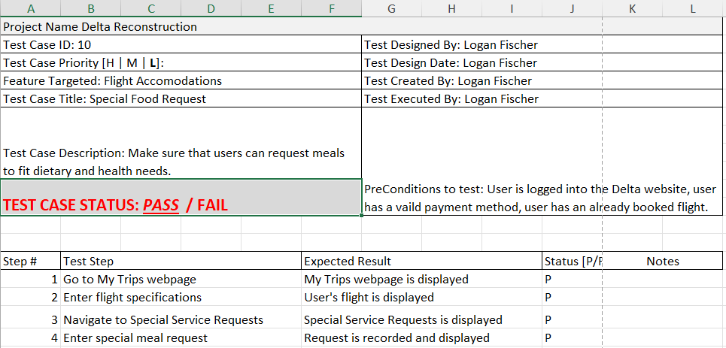
Test Case (Meal Requests)

Slide 20
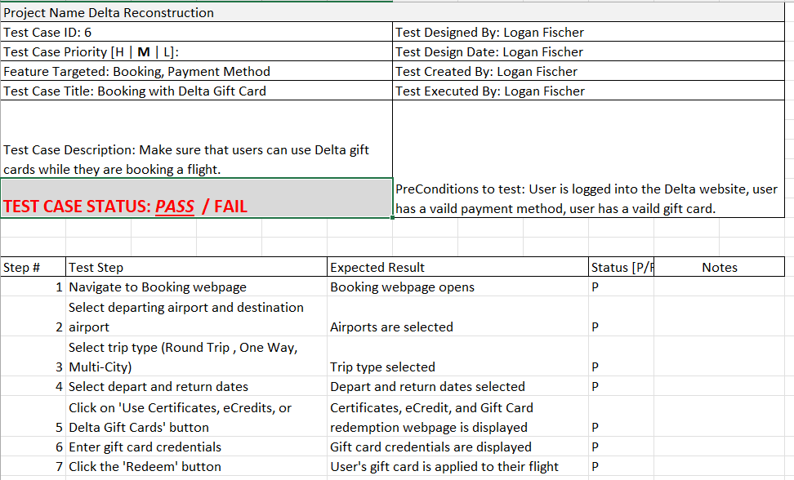
Test Case (Certificate Application)

Slide 21
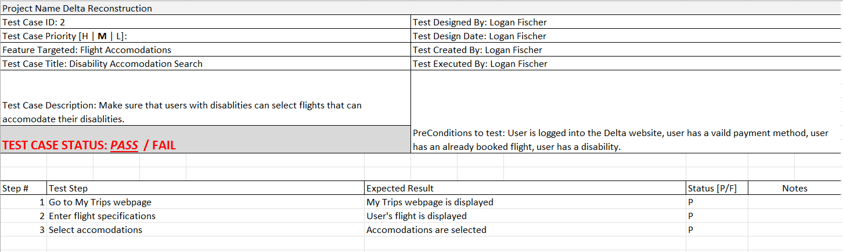
Test Case (Disability Searching)

Slide 22
Summary of Test Case Metrics:
Test Case Pass/Fail Percentage
Passed Test Cases: 0.94 or 94% Pass Rate
Failed Test Cases: 0.06 or 6% Fail Rate
Test Case Priority Rates
Low Priority Test Cases: 7.5%
Medium Priority Test Cases: 50%
High Priority Test Cases: 42.5%

Slide 23
Defects Overview:
Total Defects Logged: 15 (three per member)
Severity Levels: Low (1), Medium (2), High (3), and Critical (4)
Defect Report Status: 100% (In Progress) and 0% (Completed)
Priortiy Levels: Low(1), Medium(2), High(3), and Highest (4)

Slide 24
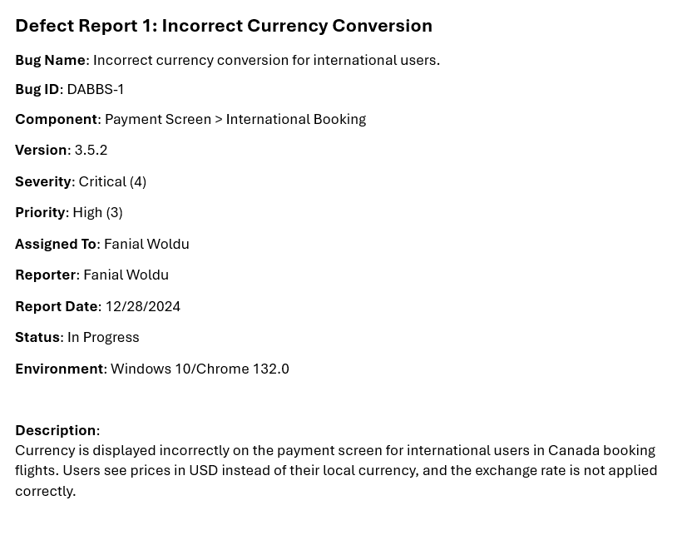
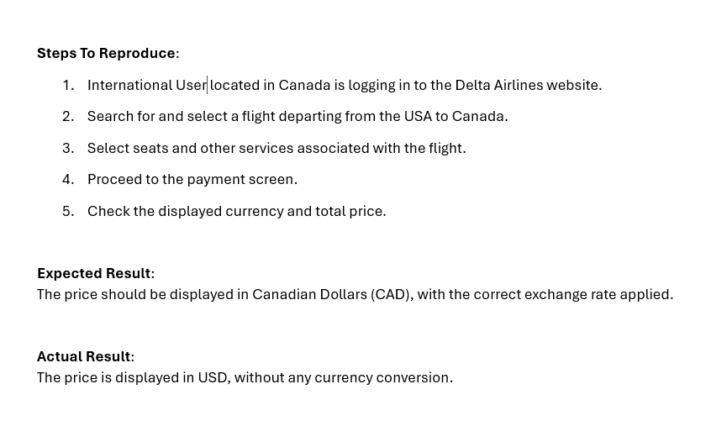
Defect Example DABBS-1

Slide 25
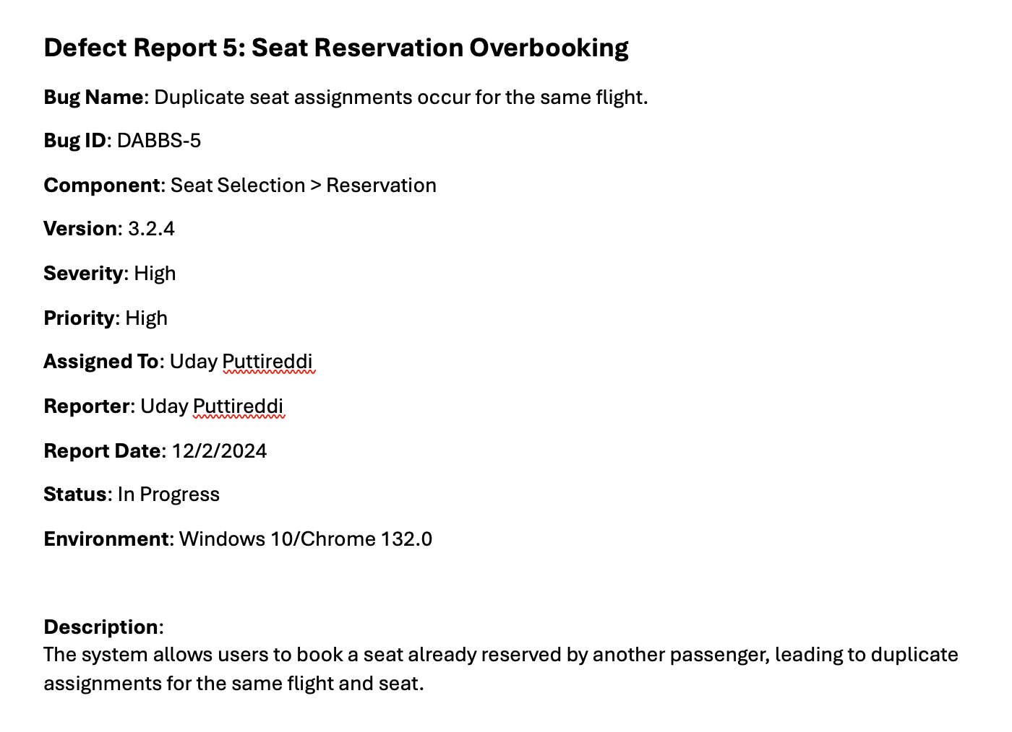
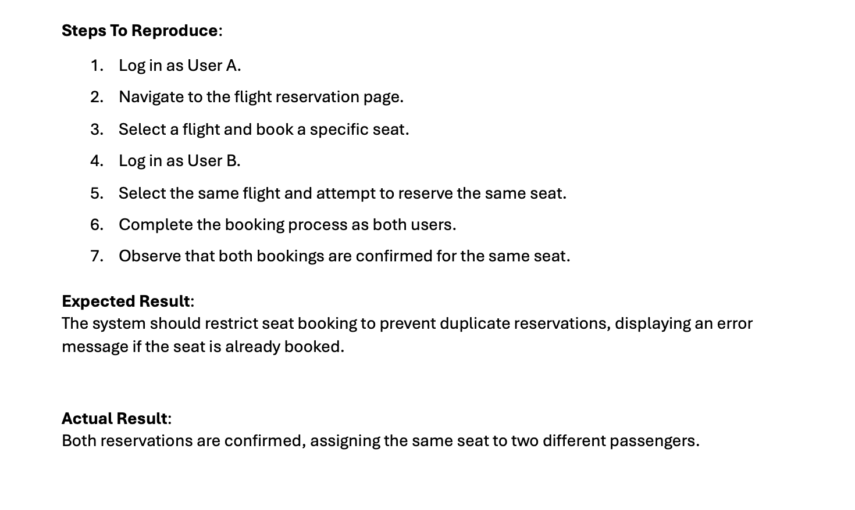
Defect Example DABBS - 5

Slide 26
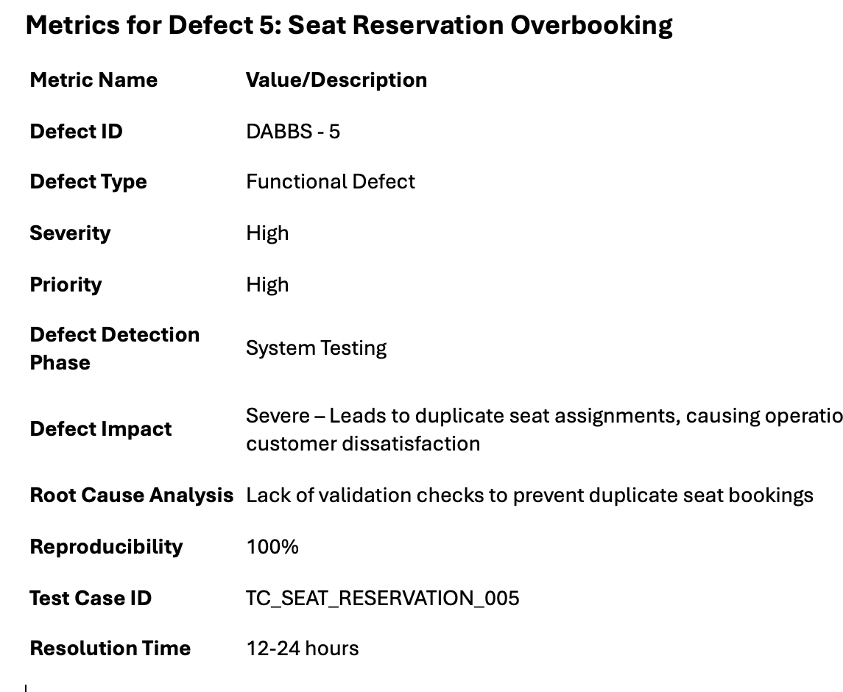
Metrics for Defect 5: Seat Reservation Overbooking

Slide 27
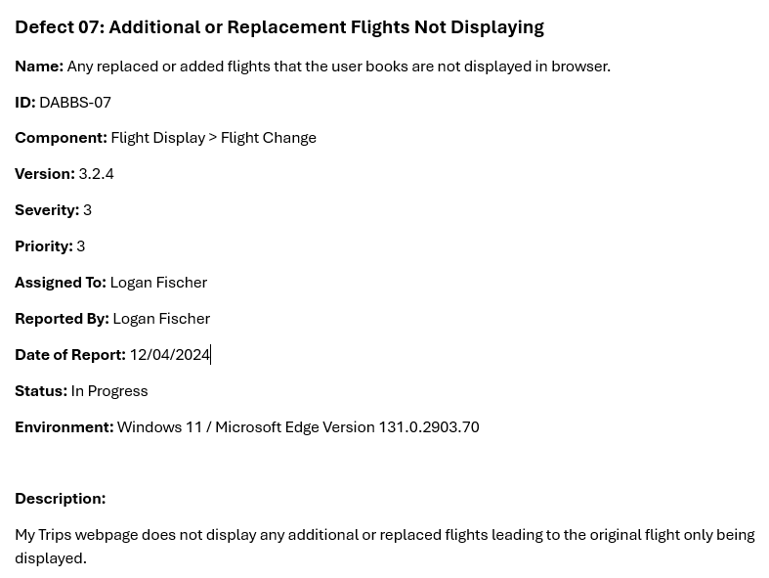
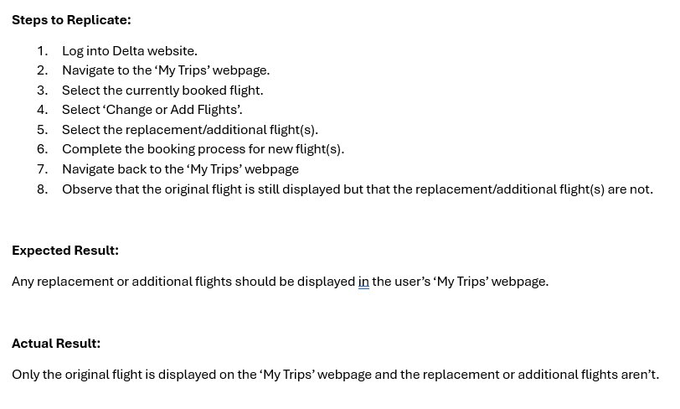
Defect Example DABBS-7

Slide 28
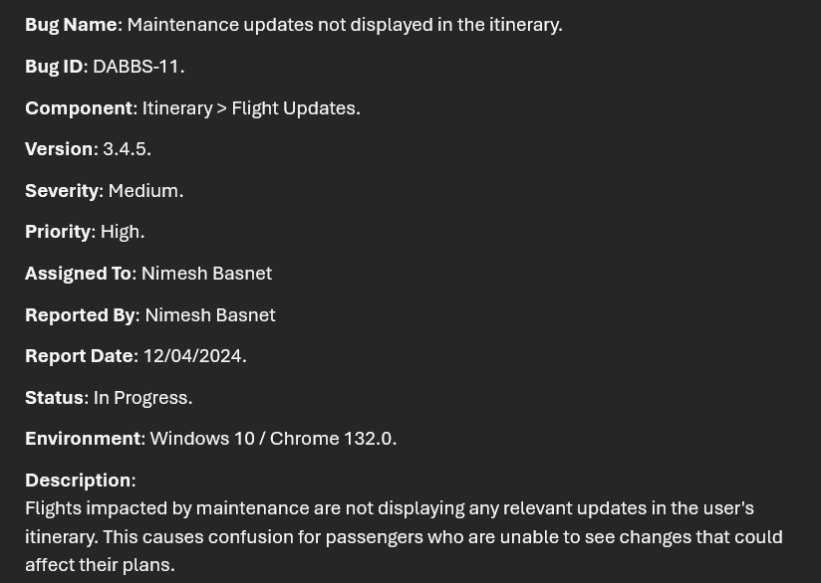
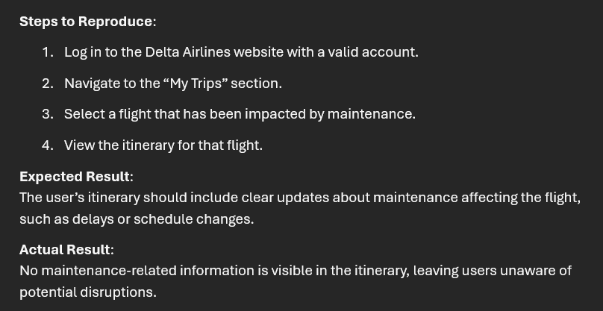
Defect Example DABBS-11

Slide 29
Defect Reports Analysis
Defect Report Priority Rates:
Low (1): 0%
Medium (2): 22%
High (3): 53%
Highest (4): 25%
Defect Report Severity Rates:
Low (1): 0%
Medium (2): 25%
High (3): 55%
Critical (4): 20%
Defect Fix Rate: 0%
Test Case Coverage: >50%
Cycle Time: Average of 4 days per defect

Slide 30
Summary and Next Steps:
Comprehensive testing and defect tracking implemented.
Focused on critical features like booking, digital ID, and payment functionality.
Key Metrics highlight progress but indicate areas for improvement.
Next Steps:
Resolve remaining high-priority defects.
Expand test case coverage to 100%.
Conduct user acceptance testing (UAT).
Final deployment and performance monitoring.

Slide 31

Questions?

